Slide 1
LTU – ECE Department EEE 5653 – 1740 & EEE 5654 - 1257 Digital Signal Processing IIR and FIR Filter Design Matlab/Simulink
Dr. Heri Rakouth/Dr. Linda Murphy
21 November 2023
Heri Rakouth

Slide 2
IIR and FIR Filters
Infinite impulse response (IIR)
Finite impulse response (FIR)
Each type of filter is categorized by the length of its impulse response. Which is better for a given digital filtering application?
There are many design performance and implementation properties to consider when choosing between an IIR or an FIR filter.
For example, from a hardware standpoint with so many fundamental differences between IIR and FIR filters, our choice must be based on those filter characteristics that are most and least important to us. If our design required that an FIR filter is the only way data rates and slight phase nonlinearity is tolerable, we might lean toward IIR filters with their reduced number of necessary multipliers per output sample. *
* Understanding Digital Signal Processing, Richard G. Lyons, Prentice Hall PTR, 2001

Slide 3
IIR and FIR Filter Characteristics Comparison
Characteristic | IIR | FIR
Number of necessary multiplications | Least | Most
Sensitivity to filter coefficient quantization | Can be high for direct form (cascade) | Very low
Probability of overflow errors | Can be high for direct form (cascade) | Very low
Stability | Must be designed in | Guaranteed
Linear phase | No | Guaranteed
Can stimulate prototype analog filters | Yes | No
Required hardware memory | Least | Most
Hardware filter control complexity | Moderate | Simple
Availability of design software | Good | Very good
Ease of design/complexity of design software | Moderately complicated | Simple
Difficulty of quantization noise analysis | Most complicated | Least complicated
Supports adaptive filtering | Yes | Yes
Understanding Digital Signal Processing, Richard G. Lyons, Prentice Hall PTR, 2001

Slide 4
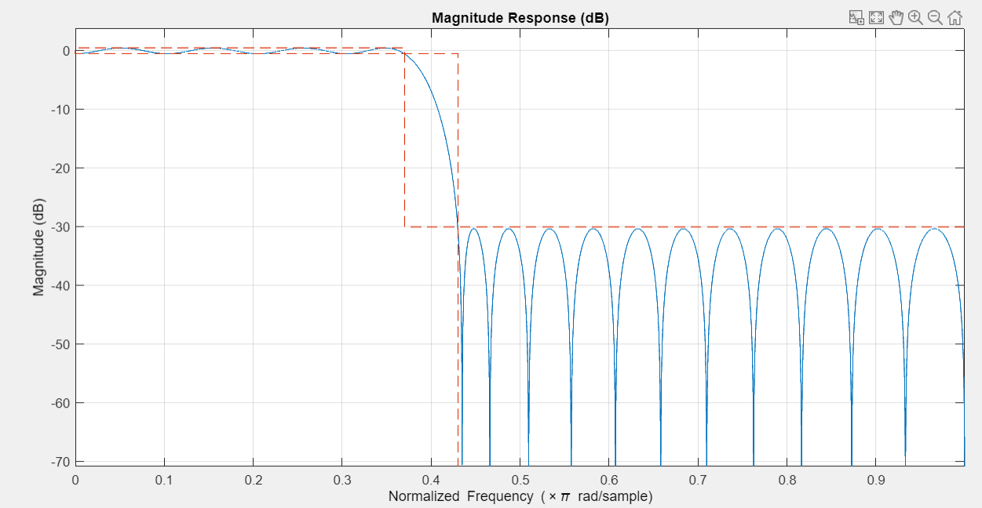
A minimum-order lowpass FIR filter
Fpass = 0.37; % passband frequency of 0.37*pi rad/sample
Fstop = 0.43; % stopband frequency of 0.43*pi rad/sample
Ap = 1; % passband ripple of 1 dB
Ast = 30; % stopband attenuation of 30 dB
% designs a digitalFilter object
d = designfilt('lowpassfir','PassbandFrequency',Fpass,...
'StopbandFrequency',Fstop,'PassbandRipple',Ap,'StopbandAttenuation',Ast);
% Filter Analysis Tool
hfvt = fvtool(d);
%% The resulting filter order can be queried
% using the filtord function
N = filtord(d)
In this case the filter order is 39.

Slide 5
A minimum-order lowpass FIR filter
'FIR Digital Filter (real) '
'------------------------- '
'Filter Length : 40 '
'Stable : Yes '
'Linear Phase : Yes (Type 2) '
' '
'Design Method Information '
'Design Algorithm : Equiripple '
' '
'Design Options '
'Density Factor : 16 '
' '
'Design Specifications '
'Sample Rate : 2 (normalized)'
'Response : Lowpass '
'Stopband Atten. : 30 dB '
'Passband Edge : 0.37 '
'Stopband Edge : 0.43 '
'Passband Ripple : 1 dB '
Use the info function to get information
about the parameters used to design the filter.
info(d)
Workspace output

Slide 6
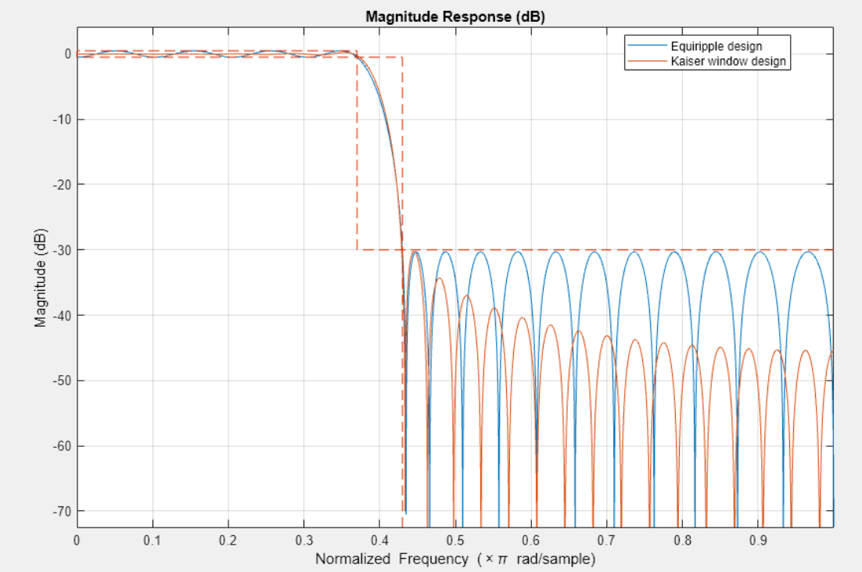
Kaiser window method for a Minimum Order Design
Using all the original values for the filter from the previous example:
Fpass = 0.37; % passband frequency of 0.37*pi rad/sample
Fstop = 0.43; % stopband frequency of 0.43*pi rad/sample
Ap = 1; % passband ripple of 1 dB
Ast = 30; % stopband attenuation of 30 dB
% designs a digitalFilter object
dk = designfilt('lowpassfir','PassbandFrequency',Fpass,...
'StopbandFrequency',Fstop,'PassbandRipple',Ap,...
'StopbandAttenuation',Ast, 'DesignMethod', 'kaiserwin');

Slide 7
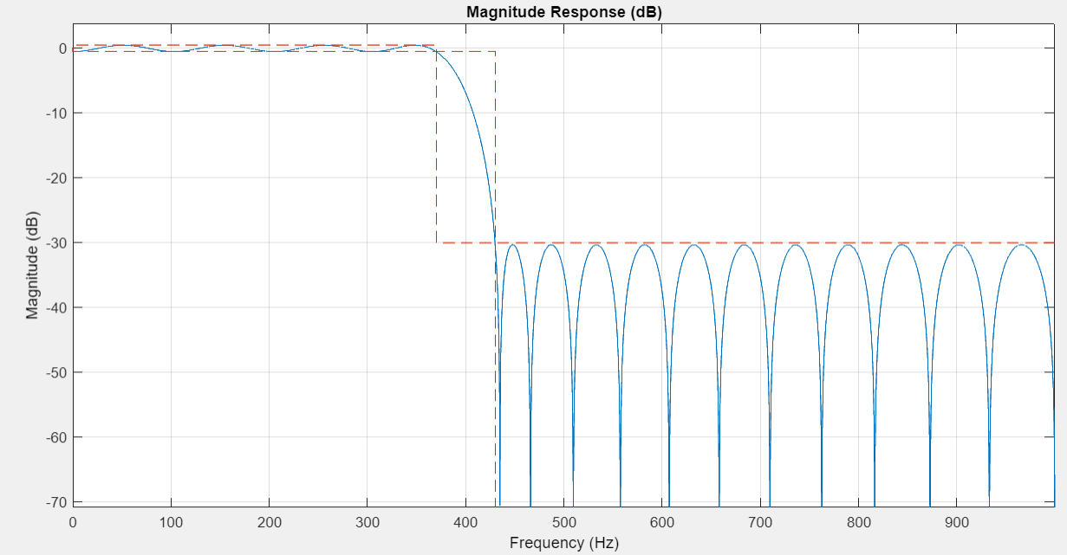
Specifying Frequency Parameters in Hertz
% Redesign the minimum-order equiripple filter for a sample rate of 2 kHz.
Fpass = 370; % passband frequency
Fstop = 430; % stopband frequency
Ap = 1; % passband ripple of 1 dB
Ast = 30; % stopband attenuation of 30 dB
Fs = 2000; % Sampling Frequency
d = designfilt('lowpassfir','PassbandFrequency',Fpass,...
'StopbandFrequency',Fstop,'PassbandRipple',Ap,...
'StopbandAttenuation',Ast,'SampleRate',Fs);
hfvt = fvtool(d);
If you know the sample rate at which the filter will
operate, you can specify the sample rate and the
frequencies in hertz.

Slide 8
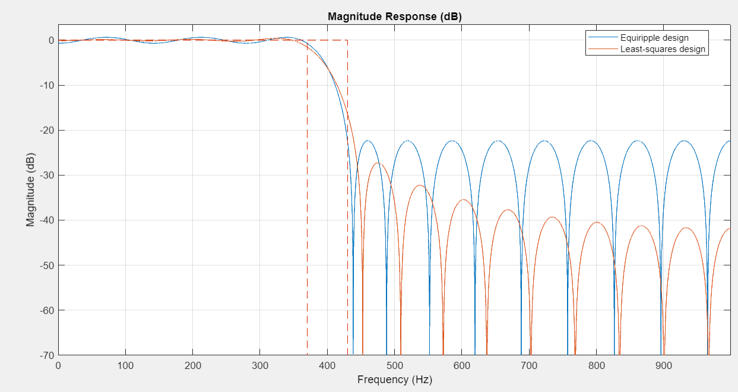
Fixed Order – Fixed Transition Width
N = 30; % order number
Fpass = 370; % passband frequency
Fstop = 430; % stopband frequency
Fs = 2000; % Sampling Frequency
% Design method defaults to 'equiripple' when omitted
deq = designfilt('lowpassfir','FilterOrder',N,'PassbandFrequency',Fpass,...
'StopbandFrequency',Fstop,'SampleRate',Fs);
dls = designfilt('lowpassfir','FilterOrder',N,'PassbandFrequency',Fpass,...
'StopbandFrequency',Fstop,'SampleRate',Fs,'DesignMethod','ls');
hfvt = fvtool(deq,dls);
legend(hfvt,'Equiripple design', 'Least-squares design')

Slide 9
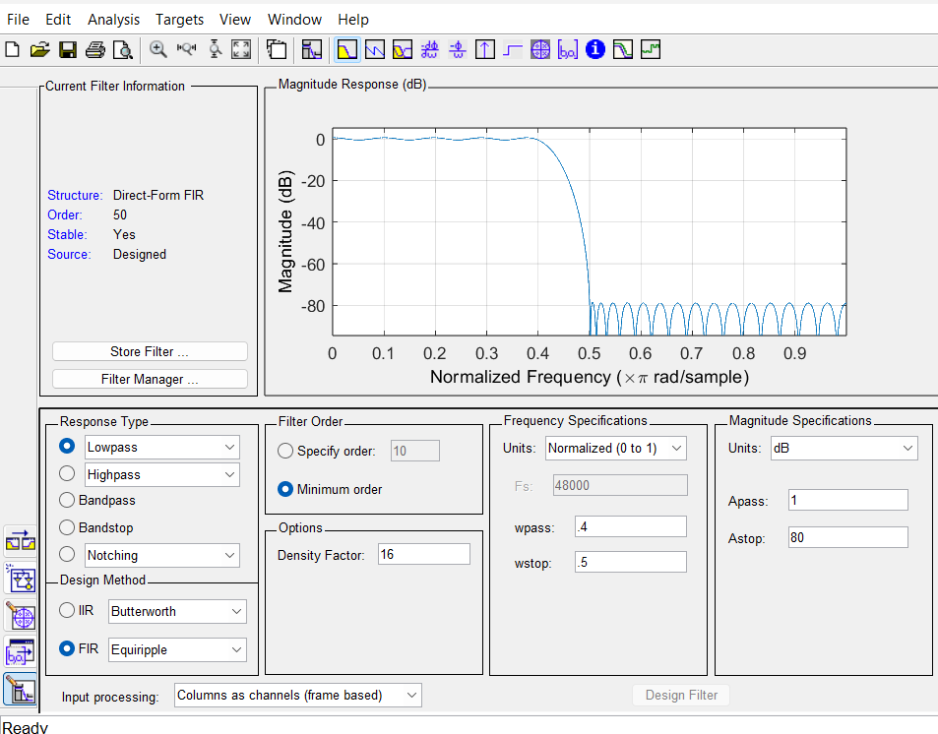
Filter Designer

Slide 10
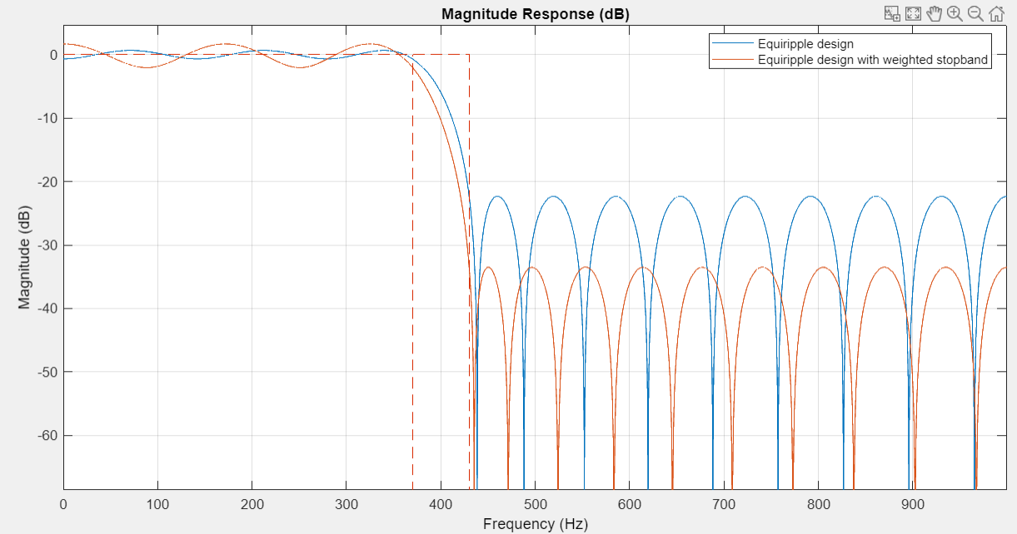
Equiripple and Weighted Stopband
deqw = designfilt('lowpassfir','FilterOrder',N,'PassbandFrequency',Fpass,...
'StopbandFrequency',Fstop,'SampleRate',Fs,...
'PassbandWeight',1,'StopbandWeight',10);
hfvt = fvtool(deq,deqw);
legend(hfvt,'Equiripple design', 'Equiripple design with weighted stopband')

Slide 11
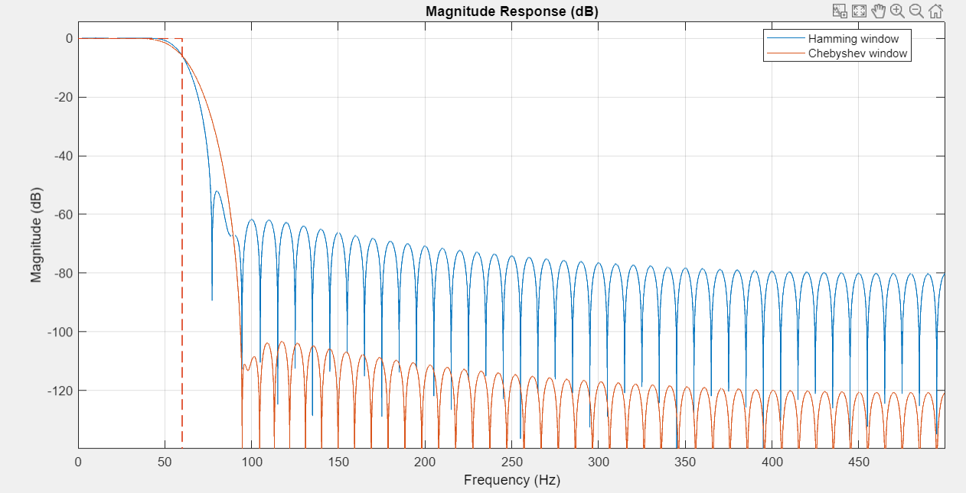
Fixed Order, Cutoff Frequency using a Window Design Method
dhamming = designfilt('lowpassfir','FilterOrder',100,'CutoffFrequency',60,...
'SampleRate',1000,'Window','hamming');
dchebwin = designfilt('lowpassfir','FilterOrder',100,'CutoffFrequency',60,...
'SampleRate',1000,'Window',{'chebwin',90});
hfvt = fvtool(dhamming,dchebwin);
legend(hfvt,'Hamming window', 'Chebyshev window')

Slide 12
IIR Filter Design & Chebyshev Type I Filters
dbutter =
digitalFilter with properties:
Coefficients: [4×6 double]
Specifications:
FrequencyResponse: 'lowpass'
ImpulseResponse: 'iir'
SampleRate: 2000
StopbandAttenuation: 60
PassbandFrequency: 100
StopbandFrequency: 300
PassbandRipple: 1
DesignMethod: 'butter'
Use fvtool to visualize filter
Use designfilt to edit filter
Use filter to filter data
Chebyshev Type I Filters
dcheby1 =
digitalFilter with properties:
Coefficients: [3×6 double]
Specifications:
FrequencyResponse: 'lowpass'
ImpulseResponse: 'iir'
SampleRate: 2000
StopbandAttenuation: 60
PassbandFrequency: 100
StopbandFrequency: 300
PassbandRipple: 1
DesignMethod: 'cheby1'

Slide 13
Chebyshev Type II & Elliptic Filters
dellip =
digitalFilter with properties:
Coefficients: [2×6 double]
Specifications:
FrequencyResponse: 'lowpass'
ImpulseResponse: 'iir'
SampleRate: 2000
StopbandAttenuation: 60
PassbandFrequency: 100
StopbandFrequency: 300
PassbandRipple: 1
DesignMethod: 'ellip'
Use fvtool to visualize filter
Use designfilt to edit filter
Use filter to filter data
dcheby2 =
digitalFilter with properties:
Coefficients: [3×6 double]
Specifications:
FrequencyResponse: 'lowpass'
ImpulseResponse: 'iir'
SampleRate: 2000
StopbandAttenuation: 60
PassbandFrequency: 100
StopbandFrequency: 300
PassbandRipple: 1
DesignMethod: 'cheby2'

Slide 14
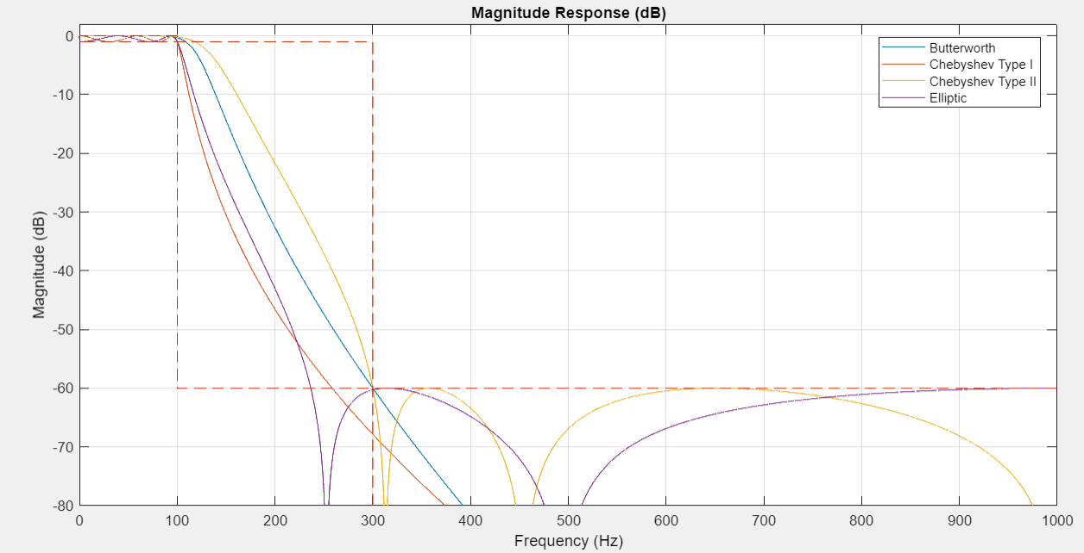
Compare the Response and the Order of the 4 IIR Filters
For the same specification constraints, the Butterworth method yields the highest order and the elliptic method yields the smallest.
FilterOrders = [filtord(dbutter) filtord(dcheby1) filtord(dcheby2) filtord(dellip)]
FilterOrders = 7 5 5 4
% plot the results
hfvt = fvtool(dbutter,dcheby1,dcheby2,dellip);
zoom(hfvt,[0 1e3 -80 2])
legend(hfvt,'Butterworth’,…
'Chebyshev Type I’, 'Chebyshev Type II','Elliptic')

Slide 15
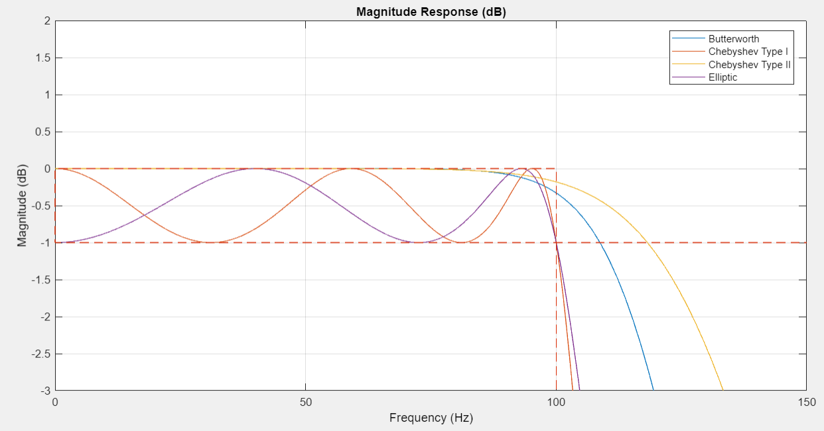
Ripple Differences
Is it better to have a higher value of ripple or lower value of it?
The magnitude of the ripple is dependent of many factors and the lower the better for most sensitive equipment. The ripple leads to power losses and overheating of components hence risk of damage in addition to inefficiency. It is therefore essential to remove or minimize the ripple in at the output.
zoom(hfvt,[0 150 -3 2])

Slide 16
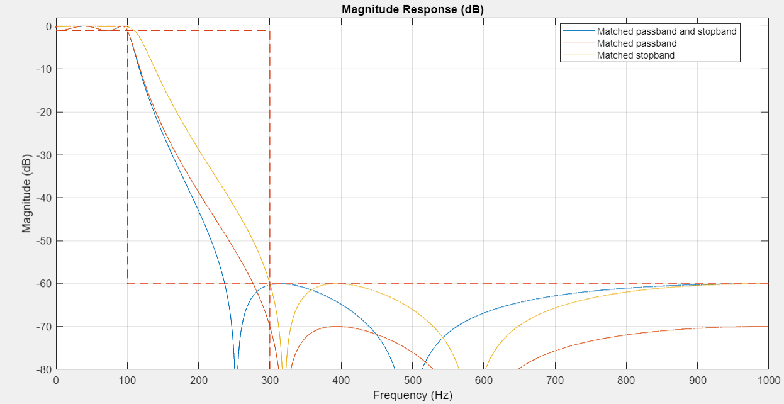
Matching Exactly the Passband or Stopband Specifications
dellip1 = designfilt('lowpassiir','PassbandFrequency',Fp,...
'StopbandFrequency',Fst,'PassbandRipple',Ap,...
'StopbandAttenuation',Ast,'SampleRate',Fs,'DesignMethod','ellip',...
'MatchExactly','passband');
dellip2 = designfilt('lowpassiir','PassbandFrequency',Fp,...
'StopbandFrequency',Fst,'PassbandRipple',Ap,...
'StopbandAttenuation',Ast,'SampleRate',Fs,'DesignMethod','ellip',...
'MatchExactly','stopband');
hfvt = fvtool(dellip, dellip1, dellip2);
legend(hfvt,'Matched passband and stopband','Matched passband',...
'Matched stopband');
zoom(hfvt,[0 1e3 -80 2]

Slide 17
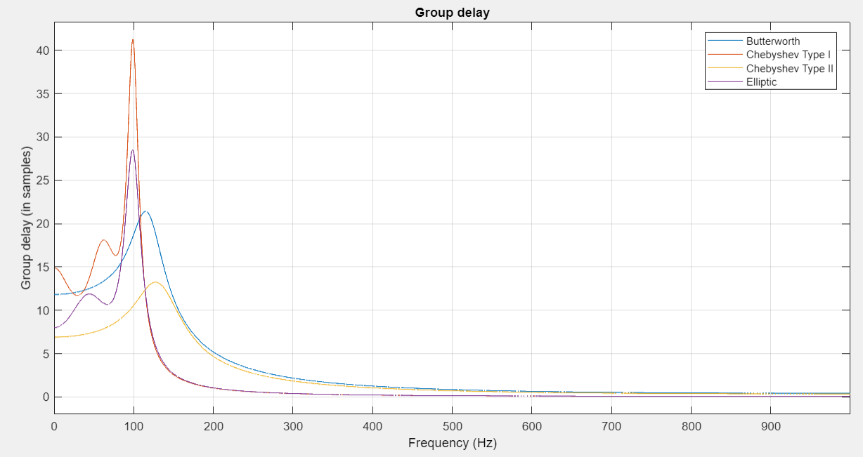
Group Delay Comparison
hfvt = fvtool(dbutter,dcheby1,dcheby2,dellip,'Analysis','grpdelay');
legend(hfvt,'Butterworth', 'Chebyshev Type I',...
'Chebyshev Type II','Elliptic')

Slide 18
IIR and FIR Conclusions
In these example, you learned how to use designfilt to obtain a variety of lowpass FIR and IIR filters with different constraints and design methods. designfilt can also be used to obtain highpass, bandpass, bandstop, arbitrary-magnitude, differentiator, and Hilbert designs. To learn more about all available options, visit Filter Design Gallery in the Mathworks documentation.
Next 3 slides are a Simulink review for the project setup.

Slide 19
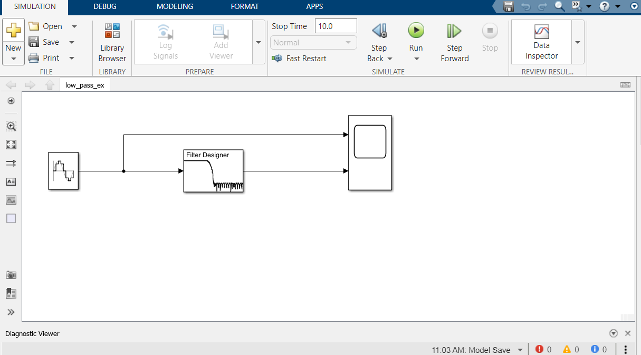
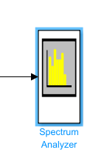
Simulink

Slide 20
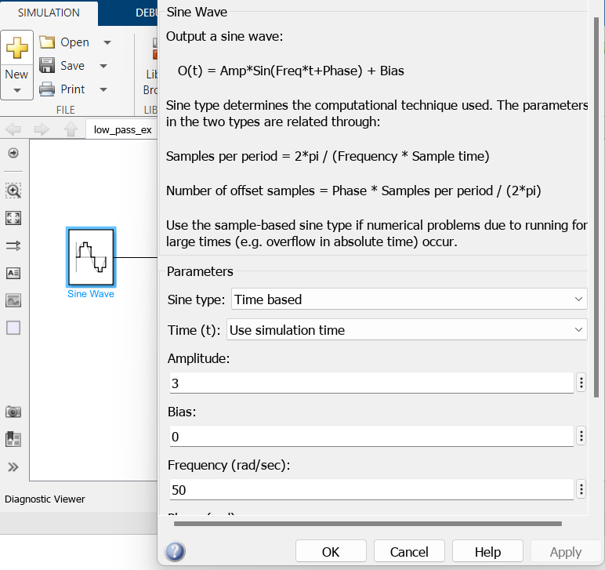
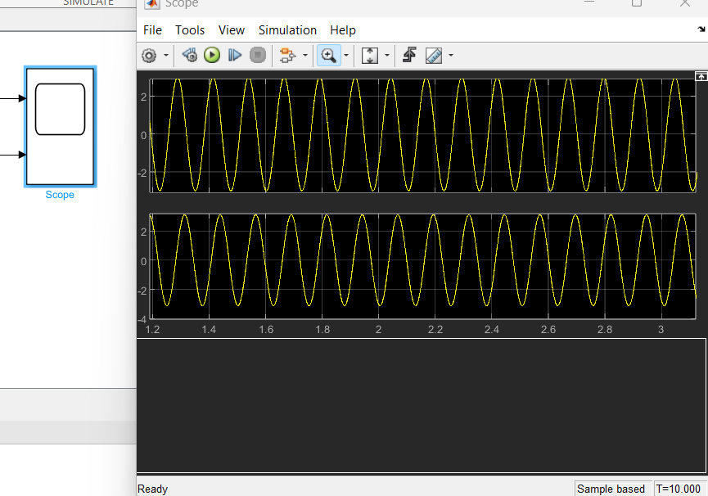
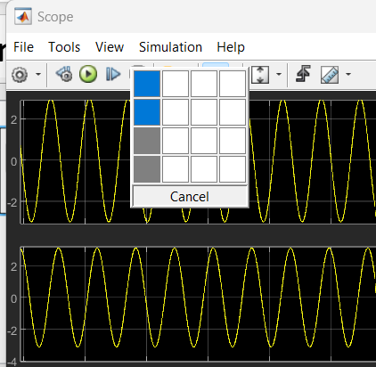
Simulink

Slide 21
Simulink

